Slide 1
CSCI1540 Fundamental Computing with C++
Recursion
Fall, 2019

Slide 2
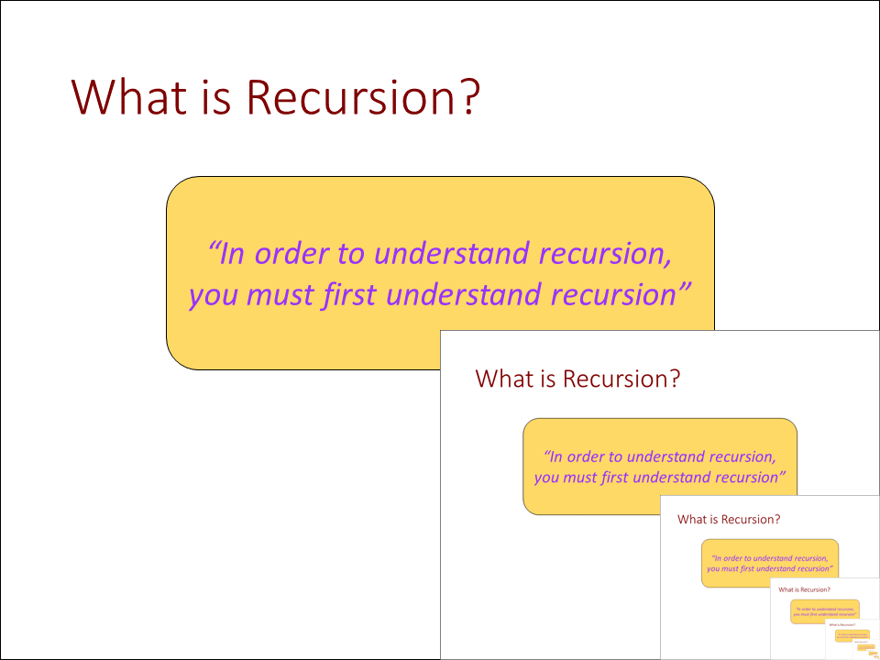
What is Recursion?
“In order to understand recursion, you must first understand recursion”

Slide 3
Basic Elements of Recursion
A recursive function is a function that contains a call to itself either directly or indirectly
It can be considered an advanced form of control flow, an alternative to iteration/repetition
Recursion usually leads to more elegant and simpler solutions, but incurs larger memory and time overhead
int foo(…) {
…
… foo(…) …; // Calls itself
…
}

Slide 4
Basic Elements of Recursion
Writing recursive programs requires “recursive thinking style” and “recursive problem-solving skills”, which can only be acquired through practice and experience
An important recursive problem-solving skill is divide-and-conquer
Divide the problem into smaller pieces
Tackle each sub-task either directly or by recursion
Combine the solutions of the parts to form the solution of the whole

Slide 5

Counting Down (Iterative): Example
Suppose we need to write a function that counts down from $N$ ($>0$) to $1$, printing $N,…, 2,1$ in turn
An iterative solution:
1
2
3
4
5
6
7
8
9
10
11
12
#include <iostream>
using namespace std;
void countDown(int n) {
for (int i = n; i > 0; i--)
cout << i << endl;
}
int main() {
countDown(5);
return 0;
}
5
4
3
2
1

Slide 6

Counting Down (Recursion): Example
A recursive solution:
If $N<1$, then do nothing and done!
If $N≥1$, then the solution consists of two sub-tasks:
Print $N$; and
Count down from $N−1$ to $1$
1
2
3
4
5
6
7
8
void countDown(int n) {
if (n >= 1) {
cout << n << endl;
countdown( n - 1 );
} // else nothing
}
Test
Recursive call
Base case (do nothing)

Slide 7
Basic Elements of Recursion
Any recursive function will include the following three basic elements:
A test to stop or continue the recursion
A base case that terminates the recursion
A recursive call that continues the recursion

Slide 8
Tracing Recursion
int main() {
countDown(5);
return 0;
}
void countDown(int n) {
if (n >= 1) {
cout << n << endl;
countdown( n - 1 );
} // else nothing
}
cout << 5 << endl;
countdown( 4 );
cout << 4 << endl;
countdown( 3 );
cout << 3 << endl;
countdown( 2 );
(Return)
(Recursive calls)
5
4
3
2
1
cout << 2 << endl;
countdown( 1 );
cout << 1 << endl;
countdown( 0 );
(Do nothing!)

Slide 9
Iteration vs Recursion
Iteration (while, do-while, for) | Recursion
Maintains and modifies loop variables in a termination condition Until the condition is met | Keeps producing simpler versions of the original problem Until some base cases are reached
void countDown(int n) {
for (int i = n; i > 0; i--)
cout << i << endl;
}
void countDown(int n) {
if (n >= 1) {
cout << n << endl;
countdown(n - 1);
} // else nothing
}

Slide 10
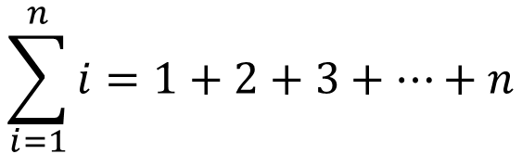

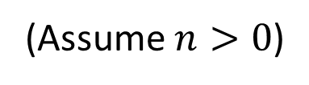
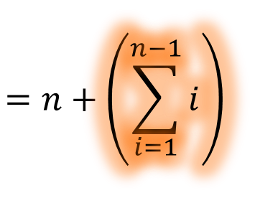

Summation $1+2+…+n$: Example
To compute:
$$\sum_{i=1}^{n}{i=1+2+3+…+n}$$
$$=\left(1+2+…+\left(n−1\right)\right)+n$$
$$=n+\left(\sum_{i=1}^{n−1}{i}\right)$$
(Assume $n>0$)
1
2
3
4
5
6
Test
int summation(int n) {
if (n == 1)
return 1;
else
return n + summation( n - 1 );
}
Base case
Recursive call

Slide 11
Summation $1+2+…+n$: Example
1
2
3
4
5
6
7
8
9
10
11
12
13
14
int summation(int n) {
if (n == 1)
return 1;
else
return n + summation( n - 1 );
}
int main() {
int n;
cout << "Enter n: ";
cin >> n;
cout << "Sum = " << summation(n) << endl;
return 0;
}
Enter n: 5↵
Sum = 15
Enter n: 14↵
Sum = 105

Slide 12
Summation $1+2+…+n$: Example
summation(5)
5 + summation(4)
5 + (4 + summation(3))
5 + (4 + (3 + summation(2)))
5 + (4 + (3 + (2 + summation(1))))
5 + (4 + (3 + (2 + 1)))
5 + (4 + (3 + 3))
5 + (4 + 6)
5 + 10
15
Recursive calls
Combining solution
int summation(int n) {
if (n == 1)
return 1;
else
return n + summation(n - 1);
}

Slide 13
String Reversal: Example
rev("abcde") → “edcba”
rev("CSCI1357") → “7531ICSC”
Reversing an empty string gets an empty string
Reversing a non-empty string gets…
1
2
3
4
5
6
string rev(string s) {
if (s == "")
return "";
else
return rev(s.substr(1)) + s.at(0);
}
rev("abcd")
→ rev("bcd") + 'a'
The substring of s from index 1 till end
substr(…) is a member function of the string class

Slide 14
Exercise
Write a recursive function (no loop inside)
int count(string s, char ch);
that counts the number of times that character ch appears in string s
E.g.:
count("Computer Science", 'e') → 3
count("Computer Science", 'a') → 0
You need > 1 recursive case
if (…) // Base case
…
else if (…) // Recur. case 1
…
else // Recur. case 2
…

Slide 15
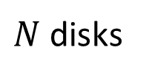


Tower of Hanoi: Example
The Tower of Hanoi is a puzzle consisting of 3 pegs and $N$ disks of different sizes
$N$ disks
$$N=4$$
Peg 1
Peg 2
Peg 3

Slide 16

Tower of Hanoi
The goal is to move the $N$ disks from peg 1 to peg 3 satisfying the following constraints:
Only one disk can be moved at a time
A larger disk cannot be on top of a smaller disk
(Move disks)
Peg 1
Peg 2
Peg 3
Peg 1
Peg 2
Peg 3
Start
Goal

Slide 17

Tower of Hanoi: Recursion
Solution for $N=1$ is trivial: (Base case)
Move the (only) disk to the required destination
Peg 1
Peg 2
Peg 3

Slide 18
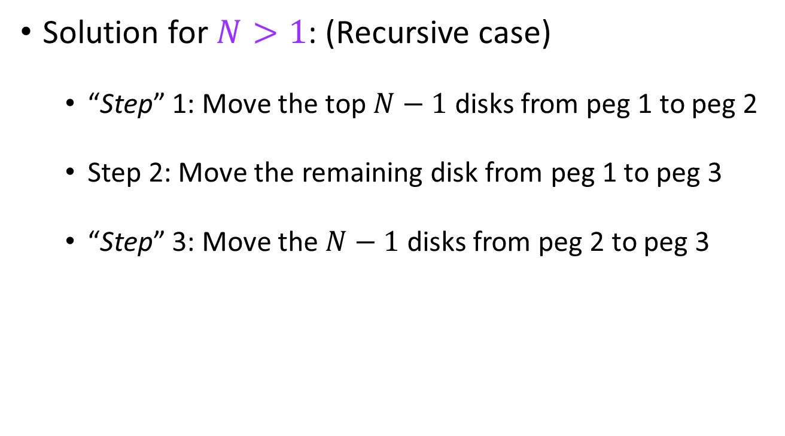
Tower of Hanoi: Recursion
Solution for $N>1$: (Recursive case)
“Step” 1: Move the top $N−1$ disks from peg 1 to peg 2
Step 2: Move the remaining disk from peg 1 to peg 3
“Step” 3: Move the $N−1$ disks from peg 2 to peg 3
“Step” 1
“Step” 3
Step 2
Peg 1
Peg 2
Peg 3

Slide 19
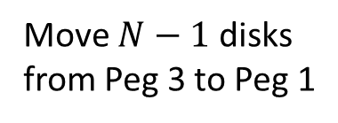
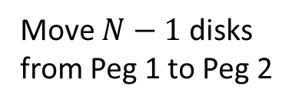
Tower of Hanoi Solution
⚠Recursion
“Step” 1
Peg 1
Peg 2
Peg 3
Peg 1
Peg 2
Peg 3
Move $N−1$ disks from Peg 1 to Peg 2
Move one disk from Peg 1 to Peg 3
Step 2
⚠Recursion
Move $N−1$ disks from Peg 3 to Peg 1
“Step” 3
Peg 1
Peg 2
Peg 3
Peg 1
Peg 2
Peg 3

Slide 20
Tower of Hanoi Solution
Original peg
Destination peg
1
2
3
4
5
6
7
8
9
10
11
12
13
14
15
16
17
void hanoi(int n, int from, int to, int buffer) {
if ( n == 1 ) {
cout << from << " --> " << to << endl;
} else {
hanoi(n - 1, from, buffer, to); // "Step" 1
cout << from << " --> " << to << endl; // Step 2
hanoi(n - 1, buffer, to, from); // "Step" 3
}
}
int main() {
int n;
cout << "Enter n: ";
cin >> n;
hanoi(n, 1, 3, 2); // From peg 1 to 3 via 2
return 0;
}
“Middle” peg

Slide 21
Tower of Hanoi Solution
Enter n: 5↵
1 --> 3
1 --> 2
3 --> 2
1 --> 3
2 --> 1
2 --> 3
1 --> 3
1 --> 2
3 --> 2
3 --> 1
2 --> 1
3 --> 2
1 --> 3
1 --> 2
3 --> 2
1 --> 3
2 --> 1
2 --> 3
1 --> 3
2 --> 1
3 --> 2
3 --> 1
2 --> 1
2 --> 3
1 --> 3
1 --> 2
3 --> 2
1 --> 3
2 --> 1
2 --> 3
1 --> 3
Enter n: 1↵
1 --> 3
Enter n: 4↵
1 --> 2
1 --> 3
2 --> 3
1 --> 2
3 --> 1
3 --> 2
1 --> 2
1 --> 3
2 --> 3
2 --> 1
3 --> 1
2 --> 3
1 --> 2
1 --> 3
2 --> 3
Enter n: 2↵
1 --> 2
1 --> 3
2 --> 3
Enter n: 3↵
1 --> 3
1 --> 2
3 --> 2
1 --> 3
2 --> 1
2 --> 3
1 --> 3

Slide 22

Tower of Hanoi: $N=3$
void hanoi(int n, int from, int to, int buffer) {
if ( n == 1 ) {
cout << from << " --> " << to << endl;
} else {
hanoi(n - 1, from, buffer, to); // "Step" 1
cout << from << " --> " << to << endl; // Step 2
hanoi(n - 1, buffer, to, from); // "Step" 3
}
}
Enter n: 3↵
1 --> 3
1 --> 2
3 --> 2
1 --> 3
2 --> 1
2 --> 3
1 --> 3
hanoi(3, 1, 3, 2);
(3 disks, Peg 1 to 3 via 2)
hanoi(2, 1, 2, 3);
cout << "1 --> 3\n";
hanoi(2, 2, 3, 1);
hanoi(1, 1, 3, 2);
cout << "1 --> 2\n";
hanoi(1, 3, 2, 1);
cout << "1 --> 3\n";
cout << "3 --> 2\n";
hanoi(1, 2, 1, 3);
cout << "2 --> 3\n";
hanoi(1, 1, 3, 2);
cout << "2 --> 1\n";
cout << "1 --> 3\n";

Slide 23
Tower of Hanoi: $N=3$
Enter n: 3↵
1 --> 3
1 --> 2
3 --> 2
1 --> 3
2 --> 1
2 --> 3
1 --> 3
Peg 1
Peg 2
Peg 3
1 → 3
Peg 1
Peg 2
Peg 3
1 → 2
Peg 1
Peg 2
Peg 3
3 → 2
Peg 1
Peg 2
Peg 3

Slide 24
Tower of Hanoi: $N=3$
1 → 3
Enter n: 3↵
1 --> 3
1 --> 2
3 --> 2
1 --> 3
2 --> 1
2 --> 3
1 --> 3
Peg 1
Peg 2
Peg 3
2 → 1
Peg 1
Peg 2
Peg 3
2 → 3
Peg 1
Peg 2
Peg 3
1 → 3
Done!
Peg 1
Peg 2
Peg 3

Slide 25

Tower of Hanoi: $N=4$
hanoi(4, 1, 3, 2);
(4 disks, Peg 1 to 3 via 2)
Enter n: 4↵
1 --> 2
1 --> 3
2 --> 3
1 --> 2
3 --> 1
3 --> 2
1 --> 2
1 --> 3
2 --> 3
2 --> 1
3 --> 1
2 --> 3
1 --> 2
1 --> 3
2 --> 3
hanoi(3, 1, 2, 3);
hanoi(1, 1, 2, 3);
hanoi(2, 1, 3, 2);
hanoi(1, 2, 3, 1);
hanoi(1, 3, 1, 2);
hanoi(2, 3, 2, 1);
hanoi(1, 1, 2, 3);
hanoi(3, 2, 3, 1);
hanoi(1, 2, 3, 1);
hanoi(2, 2, 1, 3);
hanoi(1, 3, 1, 2);
hanoi(1, 1, 2, 3);
hanoi(2, 1, 3, 2);
hanoi(1, 2, 3, 1);

Slide 26
Pitfall of Recursion
Recursive function calls incur both time and memory overheads since a runtime stack must be maintained for the function calls
Space to store the growing runtime stack
Time to add and remove information from the runtime stack

Slide 27
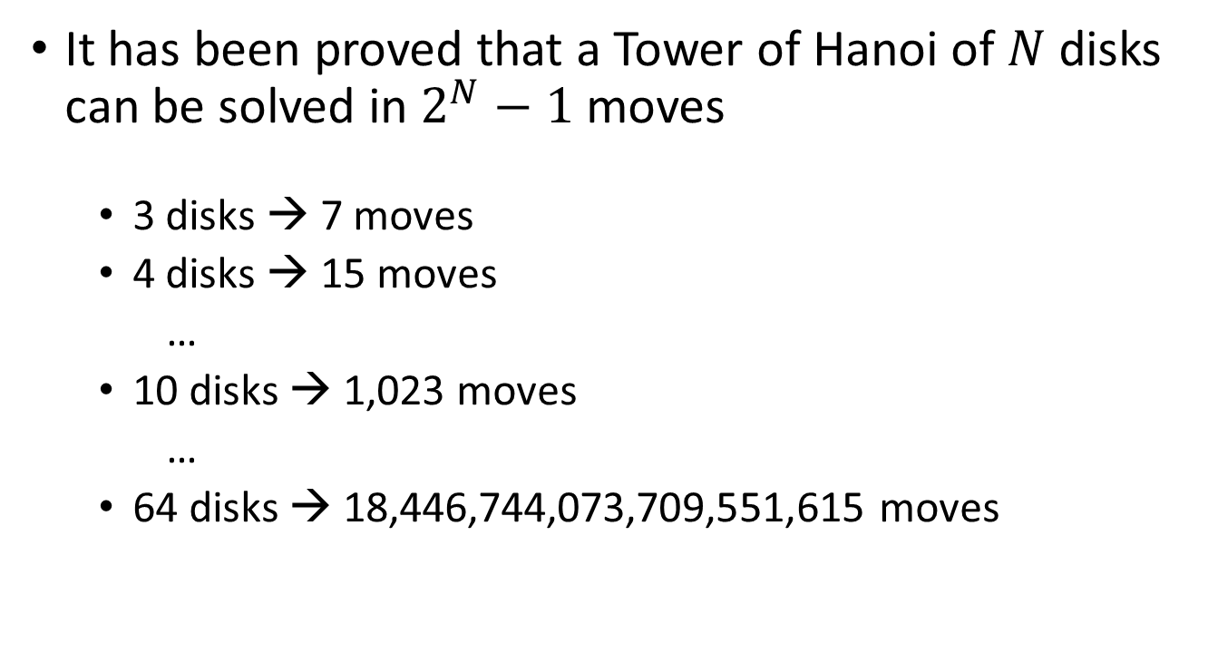
Tower of Hanoi
It has been proved that a Tower of Hanoi of $N$ disks can be solved in $2^{N}−1$ moves
3 disks → 7 moves
4 disks → 15 moves
…
10 disks → 1,023 moves
…
64 disks → 18,446,744,073,709,551,615 moves

Slide 28
Fibonacci Series: Example
The Fibonacci Series
0, 1, 1, 2, 3, 5, 8, 13, 21, 34, 55, 89, 144, …
Begins with 0 and 1
Each subsequent Fibonacci number is the sum of the previous two Fibonacci numbers in the series

Slide 29
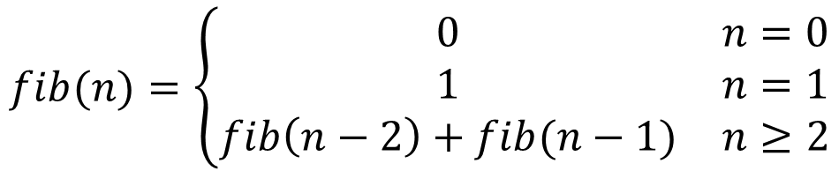
Fibonacci Series: Recursion
$$fib(n)=\left\{\begin{matrix}0 & n=0 \\ 1 & n=1 \\ fib\left(n−2\right)+fib(n−1) & n≥2\end{matrix}\right.$$
0, 1, 1, 2, 3, 5, 8, 13, 21, 34, 55, 89, 144, 233, …
1
2
3
4
5
6
7
8
long long fib( int n ) {
if (n == 0)
return 0;
else if (n == 1)
return 1;
else
return fib(n - 2) + fib(n - 1);
}

Slide 30
Fibonacci Series: Recursion
When recursive functions are designed carelessly, it can lead to very inefficient and unacceptable solutions
E.g., the recursive Fibonacci series solution:
1
2
3
4
5
6
7
8
long long fib( int n ) {
if (n == 0)
return 0;
else if (n == 1)
return 1;
else
return fib(n - 2) + fib(n - 1);
}

Slide 31
Excessive Repetition
fib(5)
Recursive Fibonacci ends up repeating the same computation numerous times!
fib(3) + fib(4)
fib(1) + fib(2)
fib(2) + fib(3)
fib(0) + fib(1)
fib(0) + fib(1)
fib(1) + fib(2)
fib(0) + fib(1)

Slide 32
Non-Recursive Fibonacci (Iteration)
1
2
3
4
5
6
7
8
9
10
11
12
13
14
15
16
17
18
long long fib( int n ) {
long long fibN, fibN1, fibN2;
if (n == 0) {
return 0;
} else if (n == 1) {
return 1;
} else {
fibN1 = 0;
fibN2 = 1;
for (int cnt = 2; cnt <= n; cnt++) {
fibN = fibN1 + fibN2; // Get the next fib num
fibN1 = fibN2;
fibN2 = fibN;
}
return fibN;
}
}

Slide 33
When (Not) to Use Recursion?
In general, use recursion if:
A recursive solution is natural and easy to understand
A recursive solution does not result in excessive duplicate computation
The equivalent iterative solution is too complex
No really clear cut guidelines!!!

Slide 34
Summary
Recursive functions have the following elements
Different cases are governed by selection (if-else)
One or more base cases have simple and non-recursive solution
Recursion is used to reduce the problem to cases that are simpler and closer to the base case
Recursion continues until a base case is reached and answers of the parts are returned and combined to form the answer of the whole
Next: Dynamic Memory Management

